Slide 1
Searching Strategies

Slide 2
Blind Search/ Uninformed
Brute Force
Huge Resources
No Control

Slide 3
Informed Search/Heuristics
Control
Set of Rules

Slide 4
Non optimal/Any Path
Whether a solution exist
Solution to particular theorem exist.

Slide 5
Optimal Path Search
Travelling Sales man

Slide 6
Simple Search Algorithm
Let S be the start state
Initialize Q with the start node Q=(S) as only entry; set Visited = (S)
If Q is empty, fail. Else pick node X from Q
If X is a goal, return X, we’ve reached the goal
(Otherwise) Remove X from Q
Find all the children of node X not in Visited
Add these to Q; Add Children of X to Visited
Go to Step 2
Notes:
The search strategies we will look at are all instances of a common search algorithm, which is shown here. The basic idea is to keep a list (Q) of nodes (that is, partial
paths), then to pick one such node from Q, see if it reaches the goal and otherwise extend that path to its neighbors and add them back to Q. Except for details, that's all
there is to it. Note, by the way, that we are keeping track of the states we have reached (visited) and not entering them in Q more than once. This will certainly avoid us ever looping, no matter how the underlying graph is connected, since we can only ever reach a state once. We will explore the impact of this decision later.

Slide 7

DFS
Depth First Search dives into a tree deeper and deeper to fine the goal state. We will use the same Simple Search Algorithm to implement DFS by keeping our priority function as

Slide 8
Simple Search Algorithm
Let S be the start state
Initialize Q with the start node Q=(S) as only entry; set Visited = (S)
If Q is empty, fail. Else pick node X from Q
If X is a goal, return X, we’ve reached the goal
(Otherwise) Remove X from Q
Find all the children of node X not in Visited
Add these to Q; Add Children of X to Visited
Go to Step 2
Notes:
The search strategies we will look at are all instances of a common search algorithm, which is shown here. The basic idea is to keep a list (Q) of nodes (that is, partial
paths), then to pick one such node from Q, see if it reaches the goal and otherwise extend that path to its neighbors and add them back to Q. Except for details, that's all
there is to it. Note, by the way, that we are keeping track of the states we have reached (visited) and not entering them in Q more than once. This will certainly avoid us ever looping, no matter how the underlying graph is connected, since we can only ever reach a state once. We will explore the impact of this decision later.

Slide 9
DFS: Example
S
A
B
C
D
E
F
G
H
 | Q | Visited
1
2
3
4
5
Notes:
We start with depth-first search using a Visited list. The table in the center shows the contents of Q and of the Visited list at each time
through the loop of the search algorithm. On the right is the graph we are searching and we will label the state of the node that is being extended at each step.

Slide 10
DFS: Example
S
A
B
C
D
E
F
G
H
 | Q | Visited
1 | S | S
2
3
4
5
Notes:
We start with depth-first search using a Visited list. The table in the center shows the contents of Q and of the Visited list at each time
through the loop of the search algorithm. The nodes in Q are indicated by reversed paths, blue is used to indicate newly added nodes (paths). On the right is the graph we are searching and we will label the state of the node that is being extended at each step.

Slide 11
DFS: Example
S
A
B
C
D
E
F
G
H
 | Q | Visited
1 | S | S
2 | A,B | S,A,B
3
4
5
Notes:
We start with depth-first search using a Visited list. The table in the center shows the contents of Q and of the Visited list at each time
through the loop of the search algorithm. The nodes in Q are indicated by reversed paths, blue is used to indicate newly added nodes (paths). On the right is the graph we are searching and we will label the state of the node that is being extended at each step.

Slide 12
DFS: Example
S
A
B
C
D
E
F
G
H
 | Q | Visited
1 | S | S
2 | A,B | S,A,B
3 | C,D,B | S,A,B,C,D
4
5
Notes:
We start with depth-first search using a Visited list. The table in the center shows the contents of Q and of the Visited list at each time
through the loop of the search algorithm. The nodes in Q are indicated by reversed paths, blue is used to indicate newly added nodes (paths). On the right is the graph we are searching and we will label the state of the node that is being extended at each step.

Slide 13
DFS: Example
S
A
B
C
D
E
F
G
H
 | Q | Visited
1 | S | S
2 | A,B | S,A,B
3 | C,D,B | S,A,B,C,D
4 | G,H,D,B | S,A,B,C,D,G,H
5
Notes:
We start with depth-first search using a Visited list. The table in the center shows the contents of Q and of the Visited list at each time
through the loop of the search algorithm. The nodes in Q are indicated by reversed paths, blue is used to indicate newly added nodes (paths). On the right is the graph we are searching and we will label the state of the node that is being extended at each step.

Slide 14
DFS: Example
S
A
B
C
D
E
F
G
H
 | Q | Visited
1 | S | S
2 | A,B | S,A,B
3 | C,D,B | S,A,B,C,D
4 | G,H,D,B | S,A,B,C,D,G,H
5 | H,D,B | S,A,B,C,D,G,H
Notes:
We start with depth-first search using a Visited list. The table in the center shows the contents of Q and of the Visited list at each time
through the loop of the search algorithm. The nodes in Q are indicated by reversed paths, blue is used to indicate newly added nodes (paths). On the right is the graph we are searching and we will label the state of the node that is being extended at each step.

Slide 15
DFS: Example
S
A
B
C
D
E
F
G
H
 | Q | Visited
1 | S | S
2 | A,B | S,A,B
3 | C,D,B | S,A,B,C,D
4 | G,H,D,B | S,A,B,C,D,G,H
5 | H,D,B | S,A,B,C,D,G,H
6 | D,B | S,A,B,C,D,G,H
Notes:
We start with depth-first search using a Visited list. The table in the center shows the contents of Q and of the Visited list at each time
through the loop of the search algorithm. The nodes in Q are indicated by reversed paths, blue is used to indicate newly added nodes (paths). On the right is the graph we are searching and we will label the state of the node that is being extended at each step.

Slide 16
DFS: Example
S
A
B
C
D
E
F
G
H
 | Q | Visited
1 | S | S
2 | A,B | S,A,B
3 | C,D,B | S,A,B,C,D
4 | G,H,D,B | S,A,B,C,D,G,H
5 | H,D,B | S,A,B,C,D,G,H
6 | D,B | S,A,B,C,D,G,H
Notes:
We start with depth-first search using a Visited list. The table in the center shows the contents of Q and of the Visited list at each time
through the loop of the search algorithm. The nodes in Q are indicated by reversed paths, blue is used to indicate newly added nodes (paths). On the right is the graph we are searching and we will label the state of the node that is being extended at each step.

Slide 17
BFS: Example
S
P(n) = height (n)
A
B
C
D
E
F
G
H
 | Q | Visited
1
2
3
4
5
Notes:
We start with depth-first search using a Visited list. The table in the center shows the contents of Q and of the Visited list at each time
through the loop of the search algorithm. The nodes in Q are indicated by reversed paths, blue is used to indicate newly added nodes (paths). On the right is the graph we are searching and we will label the state of the node that is being extended at each step.

Slide 18
BFS: Example
S
A
B
C
D
E
F
G
H
 | Q | Visited
1 | S | S
2
3
4
5
Notes:
We start with depth-first search using a Visited list. The table in the center shows the contents of Q and of the Visited list at each time
through the loop of the search algorithm. The nodes in Q are indicated by reversed paths, blue is used to indicate newly added nodes (paths). On the right is the graph we are searching and we will label the state of the node that is being extended at each step.

Slide 19
BFS: Example
S
A
B
C
D
E
F
G
H
 | Q | Visited
1 | S | S
2 | A,B | S,A,B
3
4
5
Notes:
We start with depth-first search using a Visited list. The table in the center shows the contents of Q and of the Visited list at each time
through the loop of the search algorithm. The nodes in Q are indicated by reversed paths, blue is used to indicate newly added nodes (paths). On the right is the graph we are searching and we will label the state of the node that is being extended at each step.

Slide 20
BFS: Example
S
A
B
C
D
E
F
G
H
 | Q | Visited
1 | S | S
2 | A,B | S,A,B
3 | B,C,D | S,A,B,C,D
4
5
Notes:
We start with depth-first search using a Visited list. The table in the center shows the contents of Q and of the Visited list at each time
through the loop of the search algorithm. The nodes in Q are indicated by reversed paths, blue is used to indicate newly added nodes (paths). On the right is the graph we are searching and we will label the state of the node that is being extended at each step.

Slide 21
BFS: Example
S
A
B
C
D
E
F
G
H
 | Q | Visited
1 | S | S
2 | A,B | S,A,B
3 | B,C,D | S,A,B,C,D
4
5
Notes:
We start with depth-first search using a Visited list. The table in the center shows the contents of Q and of the Visited list at each time
through the loop of the search algorithm. The nodes in Q are indicated by reversed paths, blue is used to indicate newly added nodes (paths). On the right is the graph we are searching and we will label the state of the node that is being extended at each step.

Slide 22
BFS: Example
S
A
B
C
D
E
F
G
H
 | Q | Visited
1 | S | S
2 | A,B | S,A,B
3 | B,C,D | S,A,B,C,D
4 | C,D,E,F | S,A,B,C,D,E,F
5
Notes:
We start with depth-first search using a Visited list. The table in the center shows the contents of Q and of the Visited list at each time
through the loop of the search algorithm. The nodes in Q are indicated by reversed paths, blue is used to indicate newly added nodes (paths). On the right is the graph we are searching and we will label the state of the node that is being extended at each step.

Slide 23
BFS: Example
S
A
B
C
D
E
F
G
H
 | Q | Visited
2 | A,B | S,A,B
3 | B,C,D | S,A,B,C,D
4 | C,D,E,F | S,A,B,C,D,E,F
5 | D,E,F,G,H | S,A,B,C,D,E,F,G,H
6
Notes:
We start with depth-first search using a Visited list. The table in the center shows the contents of Q and of the Visited list at each time
through the loop of the search algorithm. The nodes in Q are indicated by reversed paths, blue is used to indicate newly added nodes (paths). On the right is the graph we are searching and we will label the state of the node that is being extended at each step.

Slide 24
BFS: Example
S
A
B
C
D
E
F
G
H
 | Q | Visited
3 | B,C,D | S,A,B,C,D
4 | C,D,E,F | S,A,B,C,D,E,F
5 | D,E,F,G,H | S,A,B,C,D,E,F,G,H
6 | E,F,G,H | S,A,B,C,D,E,F,G,H
7
Notes:
We start with depth-first search using a Visited list. The table in the center shows the contents of Q and of the Visited list at each time
through the loop of the search algorithm. The nodes in Q are indicated by reversed paths, blue is used to indicate newly added nodes (paths). On the right is the graph we are searching and we will label the state of the node that is being extended at each step.

Slide 25
BFS: Example
S
A
B
C
D
E
F
G
H
 | Q | Visited
4 | C,D,E,F | S,A,B,C,D,E,F
5 | D,E,F,G,H | S,A,B,C,D,E,F,G,H
6 | E,F,G,H | S,A,B,C,D,E,F,G,H
7 | F,G,H | S,A,B,C,D,E,F,G,H
8
Notes:
We start with depth-first search using a Visited list. The table in the center shows the contents of Q and of the Visited list at each time
through the loop of the search algorithm. The nodes in Q are indicated by reversed paths, blue is used to indicate newly added nodes (paths). On the right is the graph we are searching and we will label the state of the node that is being extended at each step.

Slide 26
BFS: Example
S
A
B
C
D
E
F
G
H
 | Q | Visited
5 | D,E,F,G,H | S,A,B,C,D,E,F,G,H
6 | E,F,G,H | S,A,B,C,D,E,F,G,H
7 | F,G,H | S,A,B,C,D,E,F,G,H
8 | G,H | S,A,B,C,D,E,F,G,H
9
Notes:
We start with depth-first search using a Visited list. The table in the center shows the contents of Q and of the Visited list at each time
through the loop of the search algorithm. The nodes in Q are indicated by reversed paths, blue is used to indicate newly added nodes (paths). On the right is the graph we are searching and we will label the state of the node that is being extended at each step.

Slide 27
BFS: Example
S
A
B
C
D
E
F
G
H
 | Q | Visited
6 | E,F,G,H | S,A,B,C,D,E,F,G,H
7 | F,G,H | S,A,B,C,D,E,F,G,H
8 | G,H | S,A,B,C,D,E,F,G,H
9 | H | S,A,B,C,D,E,F,G,H
10
Notes:
We start with depth-first search using a Visited list. The table in the center shows the contents of Q and of the Visited list at each time
through the loop of the search algorithm. The nodes in Q are indicated by reversed paths, blue is used to indicate newly added nodes (paths). On the right is the graph we are searching and we will label the state of the node that is being extended at each step.

Slide 28
BFS: Example
S
A
B
C
D
E
F
G
H
 | Q | Visited
6 | E,F,G,H | S,A,B,C,D,E,F,G,H
7 | F,G,H | S,A,B,C,D,E,F,G,H
8 | G,H | S,A,B,C,D,E,F,G,H
9 |  | S,A,B,C,D,E,F,G,H
10 |  | S,A,B,C,D,E,F,G,H
Notes:
We start with depth-first search using a Visited list. The table in the center shows the contents of Q and of the Visited list at each time
through the loop of the search algorithm. The nodes in Q are indicated by reversed paths, blue is used to indicate newly added nodes (paths). On the right is the graph we are searching and we will label the state of the node that is being extended at each step.

Slide 29
BFS: Example
S
A
B
C
D
E
F
G
H
 | Q | Visited
1 | S | S
2 | A,B | S,A,B
3 | B,C,D | S,A,B,C,D
4 | C,D,E,F | S,A,B,C,D,E,F
5 | D,E,F,G,H | S,A,B,C,D,E,F,G,H
6 | E,F,G,H | S,A,B,C,D,E,F,G,H
7 | F,G,H | S,A,B,C,D,E,F,G,H
8 | G,H | S,A,B,C,D,E,F,G,H
9 | H | S,A,B,C,D,E,F,G,H
10 |  | S,A,B,C,D,E,F,G,H
Notes:
We start with depth-first search using a Visited list. The table in the center shows the contents of Q and of the Visited list at each time
through the loop of the search algorithm. The nodes in Q are indicated by reversed paths, blue is used to indicate newly added nodes (paths). On the right is the graph we are searching and we will label the state of the node that is being extended at each step.

Slide 30
Problem with BFS
Imagine searching a tree with branching factor 8 and depth 10. Assume a node requires just 8 bytes of storage. The breadth first search might require up to:
= (8)¹⁰ nodes
= (2³)¹⁰ X 2³ ⁼ 2³³ bytes
= 8,000 Mbytes
= 8 Gbytes
Notes:
Total number of paths in a tree with branching factor b and depth d = b**d (PHW 66)
Here it is 8**10 paths. Now if each node requires 8 bytes of storage we require (8**10) * 8 bytes. In general, then, the number of paths is said to explode exponentially as the depth of the search tree increases.

Slide 31
Problems with DFS and BFS
DFS has small space requirements (linear in depth) but has major problems:
DFS can run forever in search spaces with infinite length paths
DFS does not guarantee finding the shallowest goal
BFS guarantees finding the lowest path even in presence of infinite paths, but it has one great problem
BFS requires a great deal of space (exponential in depth)

Slide 32
Progressive Deepening
S
A
B
C
D
E
F
G
H
I
J
K
L
M
N

Slide 33
Progressive Deepening
S
A
B
C
D
E
F
G
H
I
J
K
L
M
N

Slide 34
Progressive Deepening
it guarantees to find the solution at a minimum depth like BFS. Imagine that there are a number of solutions below level 4 in the tree.
The procedure would only travel a small portion of the search space and without large memory requirements, will find out the solution.

Slide 35
Heuristically Informed
Heuristic Example
  Here you see the distances between each city and the goal
  If you wish to reach the goal, it is usually better to be in a city that is close, but not necessarily; city C is closer than, but city C is not a good place to be
A
B
3
C
5
2
6
S
G
4
D
E
3
F
3
3
3
A
B
C
2
4
4
G
S
3
D
E
F
2
1
3
Notes:
Page 43 of Elaine Rich

Slide 36
Hill Climbing
S
9
11
A
B
7.3
8.5
9
9
C
D
E
F
7
G
H
5
I
J
6
6
4
4
K
2
L
0
M
N
Hill Climbing is DFS with a heuristic measurement
that orders choices. The numbers beside the
nodes are straight-line distances from the path-
terminating city to the goal city.

Slide 37
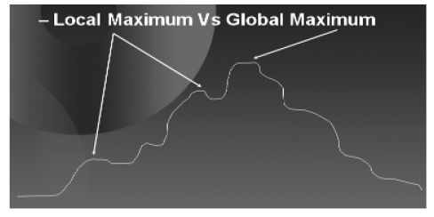
Hill Climbing
Example:
  Blind person climbing a hill.

Slide 38
Hill Climbing
Plateau
Similarly, consider another problem as depicted in the diagram below. Mountains where flat areas called plateaus are frequently encountered the blind person might again get stuck.

Slide 39

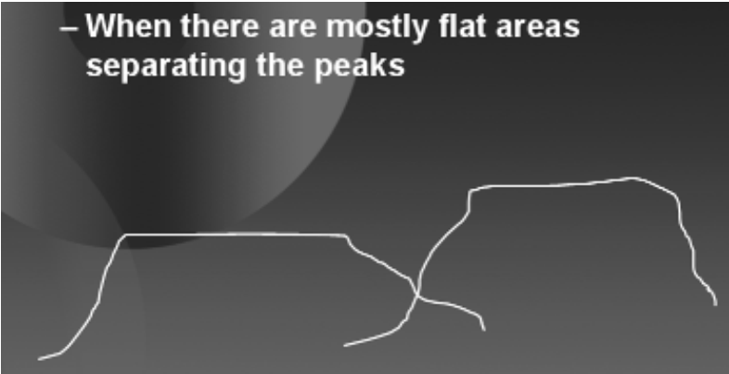
Hill Climbing

Slide 40
Hill Climbing
Ridge Problem
Consider another problem; you are standing on what seems like a knife edge contour running generally from northeast to southwest. If you take step in one direction it takes you lower, on the other hand when you step in some other direction it gives you no improvement.

Slide 41
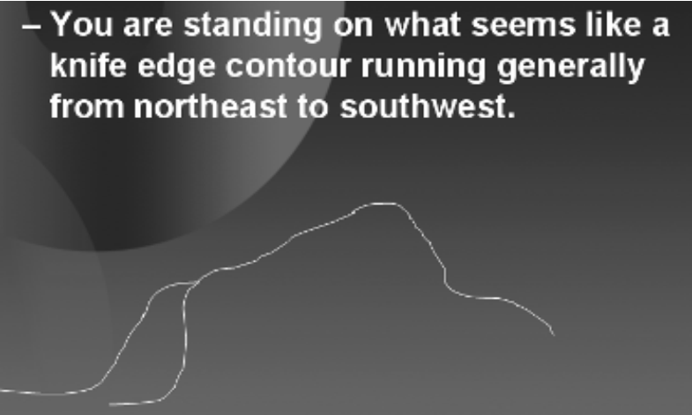
Hill Climbing

Slide 42
Hill Climbing
When we start at S we see that if we move to A we will be left with 9 units to travel.
S
9
11
A
B
7.3
8.5
7.1
9
C
D
E
F
7
G
H
5
I
J
5.3
6
2
4
K
2.5
L
0
M
N

Slide 43
Standing on A we see that C takes us closer to the goal hence we move to C.
S
9
11
A
B
7.3
8.5
7.1
9
C
D
E
F
7
G
H
5
I
J
5.3
6
2
4
K
2.5
L
0
M
N

Slide 44
From C we see that city H give us more improvement hence we move to H and then finally to L.
S
9
11
A
B
7.3
8.5
7.1
9
C
D
E
F
7
G
H
5
I
J
5.3
6
2
4
K
2.5
L
0
M
N

Slide 45
Beam Search
Degree = 2
At every level use only 2
best nodes
S
9
11
A
B
7.3
8.5
7.1
9
C
D
E
F
7
G
H
5
I
J
5.3
6
2
4
K
2.5
L
0
M
N

